Slide 1

Meraki Firmware Upgrade Tool
GVE DevNet
Global Sales Segment : Global Enterprise/Global Public Sector/Global Commercial and Small
Industries : Cities and Communities/Education/Financial Services/Government/Health Care/Manufacturing/Oil and Gas/Retail/Transportation/Utilities
LoB : Operations Automation/Operation Analytics
Architectural Plays : Enterprise
Sales Plays : Enable Secure Access/Modernize the Workforce Experience for Enterprise/Enable Secure Access for Enterprise/Other
Stien Vanderhallen
Technical Solutions Specialist
June 2022
Notes:
Notes: If your use case applies to morer than one or even all industries please keep all the industries and BOLD the industry where the PoV fits.
Smart City/Health Care/Industry and Manufacturing/Hospitality/Education/Retail/Utilities/Logistics/Professional Services/Public Sector/Service Provider
For LoB applies the same : if there is just one LoB, delete others, and bold the LoB that PoV is about.
LoB ; Safe and Security/Operations Automation/Human Resources/Operation Analytics
Please only keep the Architectural Plays that PoV is about.
Architectural Play : Enterprise / Data Center / Security / Collaboration / Service Provider

Slide 2
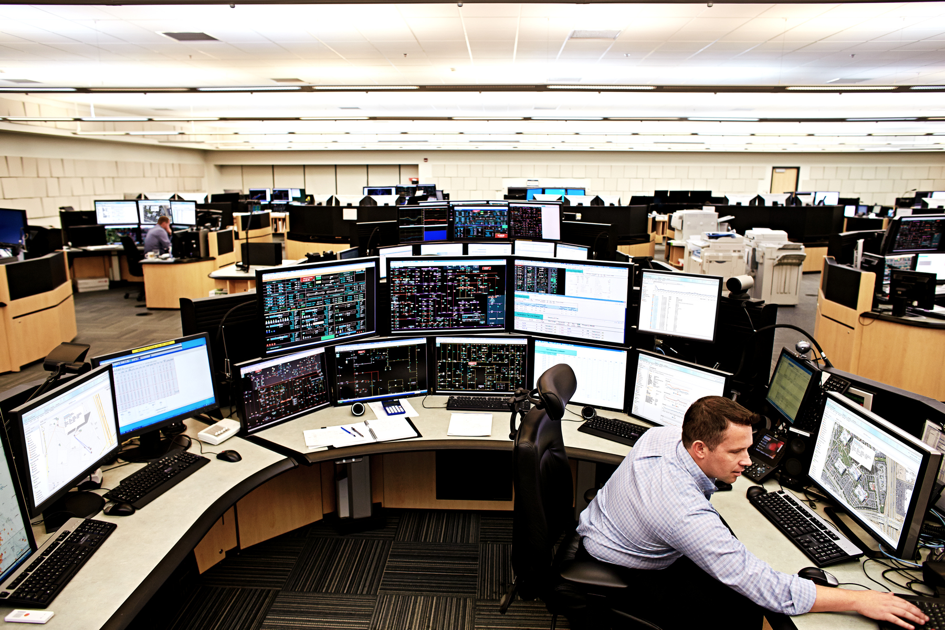
Enterprise
Operations Automation
Notes:
Please under Industry Alignment just types the Industry that PoV was created as well LoB
For the pictures, when you go to the bx.cisco.com link and select brand categories and the select photograpy you can use the engine text box to look for industry pictures and download it

Slide 3
Meraki Firmware Upgrade Tool
Business Needs/Challenges
Need: The customer wants to ensure the firmware on their Meraki devices to be up to date.
Challenge: In their large infrastructure, it is difficult to schedule, monitor and maintain firmware upgrades manually.
Solution
The solution (1) gives an overview of the firmware versions currently in use at the customer’s Meraki networks, and (2) allows to schedule firmware upgrades to the customer’s desired version.
Business Outcomes
The customer can now rest assured that the firmware versions present in their networks are up to date, without having to worry about significant manual labor necessary to enable that.
Notes:
Notes :
At the top Select a short name of the PoV naming product or products involved
Insert the logo f the customer when applies (if it is a general use case ignore the insert logo)
For Business Needs/Challenges :
For bullet Need : Write a small sentence that in an objective way to express the problem to solve when you refer to this problem, avoid to use technical words, uses business language as C-Level
For bullet Challenge : Write the main challenge and drawback the customer has to solve the problem (also avoid technical words, make a message in C-Level)
Solution :
Describe in a small sentence what is the solution about to deal with the problem referred, again, please avoid to uses technical words and use C-Level language
Business Outcomes:
Use small paragraph to show the benefits and gains with the solution explained above, please avoide to uses technical words and use C-Level language

Slide 4
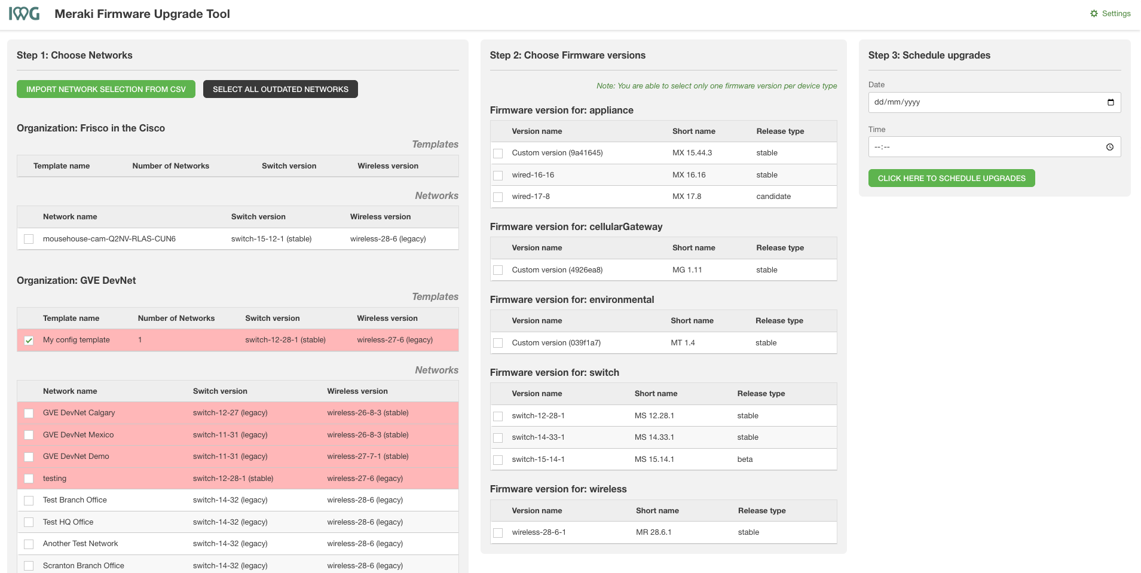
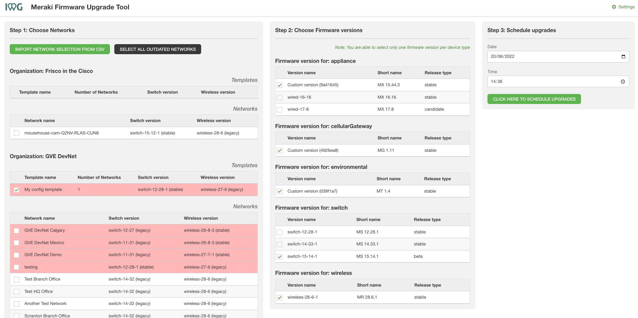
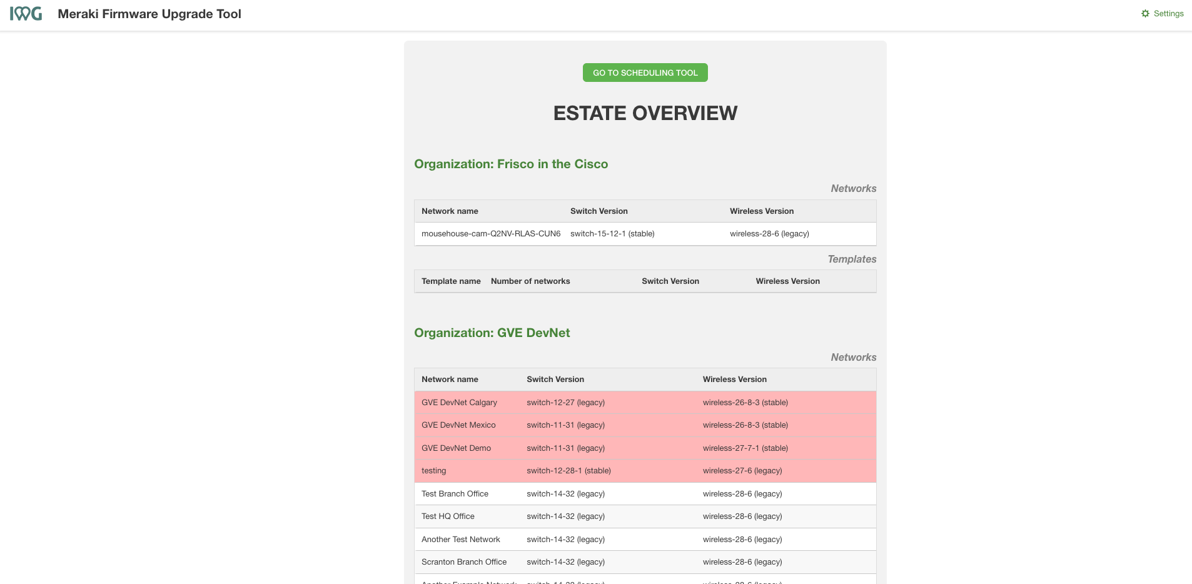

Meraki Firmware Upgrade Tool
Estate overview
Firmware selection
Upgrade scheduling
The user consults the firmware versions present in their Meraki organisations.
The user selects which networks they want to upgrade, to which version.
The user schedules firmware upgrades for a time suitable to them.
Notes:
Notes :
Use this slide to explain the story around your solution. It is a prototype in high level point of view. Think about a explanation of your solution to an executive that does not know Cisco and deep dive technology
This slide it is also to share knowledge with a non-technical guy (like BDM or sales or C-Level) what is the solution about and how will work . You can do as many steps as you need to describe the main flow of the solution
LINK for Icons https://www.flaticon.com/

Slide 5
Meraki Firmware Upgrade Tool
Customer / Opportunity
The customer is a holding company with a large Meraki infrastructure deployment.
What is the story? What was the business challenge?
The customer is set on updating the firmware versions of their equipment regularly. However, this is a tedious task when done manually. The Meraki cloud does allow for automated firmware updates, but on a “best effort” basis, i.e., there is no guarantee all devices are working and/or on the most up-to-date firmware versions at all time.
What the PoV accomplished?
The solution (1) gives an overview of the firmware versions currently in use at the customer’s Meraki networks, and (2) allows to schedule firmware upgrades to the customer’s desired version.
What are the benefits to the customer?
The customer can now rest assured that the firmware versions present in their networks are up to date, without having to worry about significant manual labor necessary to enable that.
Notes:
Notes :
*** From the side to the rest you can use all technical wording and reference from Cisco APIs, integrations and tools
Please fill the slide thinking about technical people and the scope of this PoV (what it is cover from the solution proposed and if there is a limitation or need a special integration to be awared
Align the bullet
What are the benefits to the customer?
With the Business Outcomes that you explain in the business case slide. And also you can add technical benefits on this slide or future steps to be added later as following steps

Slide 6
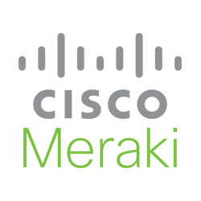

High Level Design PoV
(1) User consults firmware versions, schedules upgrades
(2) Tool schedules firmware upgrades with Meraki cloud
Notes:
Notes:
Describe the High level design and flow for the PoV and mentioned the tools used
Do not forget to add the link to github repository or other specifcs needs

Slide 7
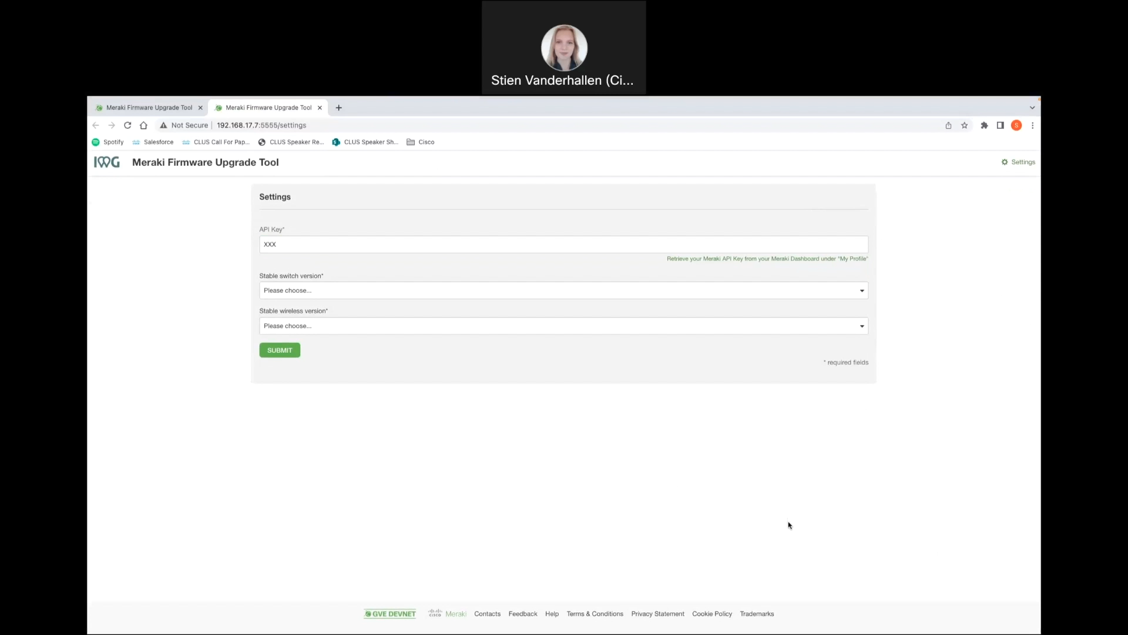
Show GUI or mockup
Notes:
Notes :
Some of the PoVs are developed either Sandboxes from dcloud, devnet or customer premises lab.
In the case the PoV is execute under Customer Premises Lab and would be hard to replicate the PoV, Please record video with the Demo and add the link to it.

Slide 8
Tools (products) Used
Python, Flask, Meraki REST API, Meraki
Notes:
Notes :
Describe all the tools,
If there is a need for a specific licenses or code versión or hardware specifications mentioned here

Slide 9
Check out the GVE Devnet team @
https://gve-devnet.cisco.com/
Open a GVE case @
https://cep.cloudapps.cisco.com/case

